Slide 1
Nature at the nanometer level: how realistic are the cartoons?
Dale W. Schaefer
Department of Biomedical, Chemical and Environmental Engineering
University of Cincinnati
Cincinnati, OH 24221-0012
dale.schaefer@uc.edu
Responsive surfaces
Clay sheets
Carbon Nanotubes
If you can sketch it, it must exist.

Slide 2
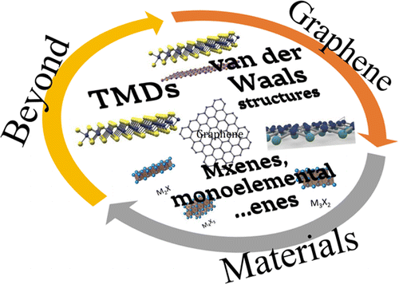
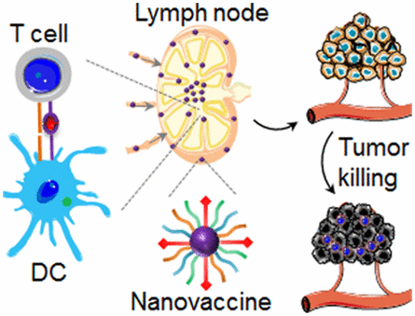
How realistic are the graphical abstracts?
Graphical Abstracts
If you can sketch it, it must exist.

Slide 3
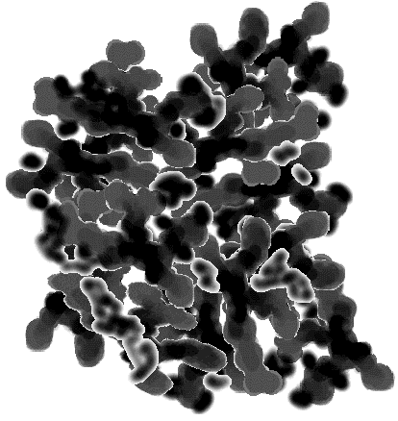
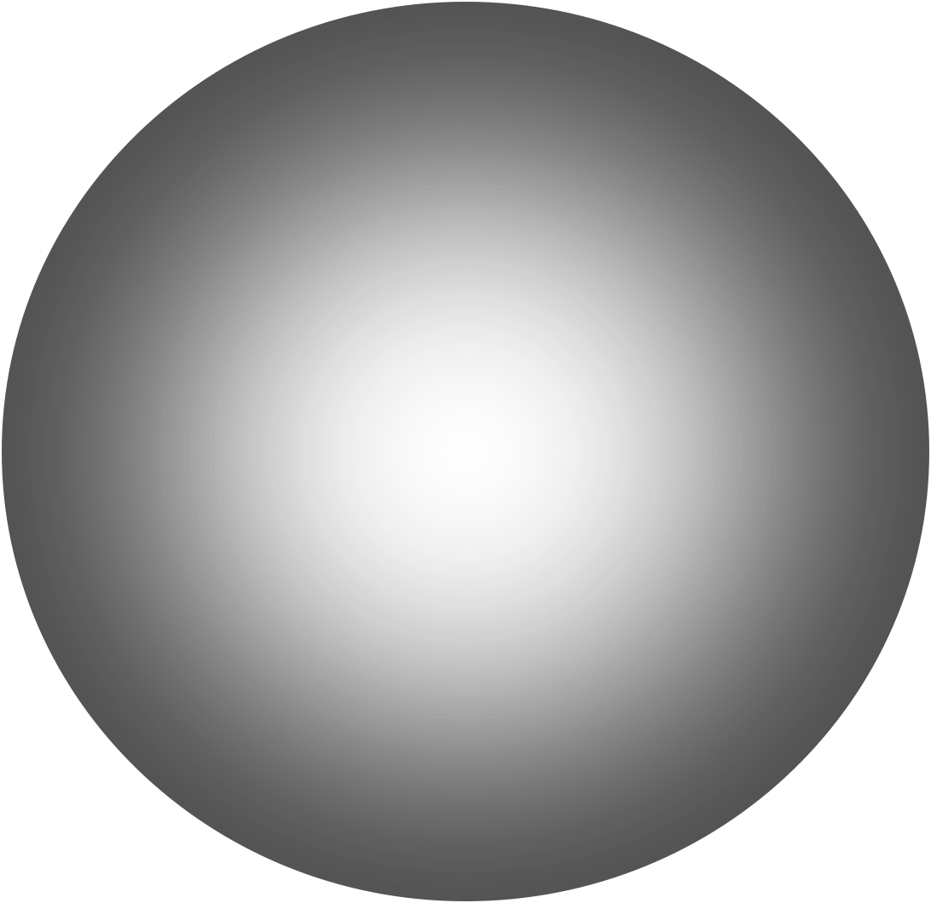
Nanoscale Reinforcing Fillers for Nanocomposites
1-d 2-d 2.5-d 3-d
Tubes
Sheets
Aggregates
Spheres
Carbon Nanotubes
Layered Silicates
Precipitated Silica
Colloidal Silica
+ Polymer Matrix
What are the implications of morphology for reinforcement?
3-d Colloidal Silica in epoxy
2.5-d Precipitated silica in rubber
1-d Carbon nanofibers in epoxy and PU thermoplastic elastomer
2-d Layered Silicates (Clays)

Slide 4
Spherical Fillers: Colloidal Silica in Epoxy
Native, Dry Nanosilica
Nanosilica in Epon862/Cure W
50 nm
50 nm
50 nm
Surface Chemistry
-Si(CH₃)
-Si(OH)
-Si(OC₂H₅)
1.3 wt%
15.0 wt%
Minimal Aggregation
“Ideal nanocomposite”
D = 12 nm = 120 Å (Manufacturer)

Slide 5
Modeling Mechanical Properties
Smallwood, H. M. Journal of Applied Physics 1944, 15, 758-766.
φ_{eff-mod} = 1.33
Smallwood:
Independent of
matrix and filler
Mechanically Rigid Zone ≈ 7 Å
Spherical fillers perform equal or better than expected.

Slide 6
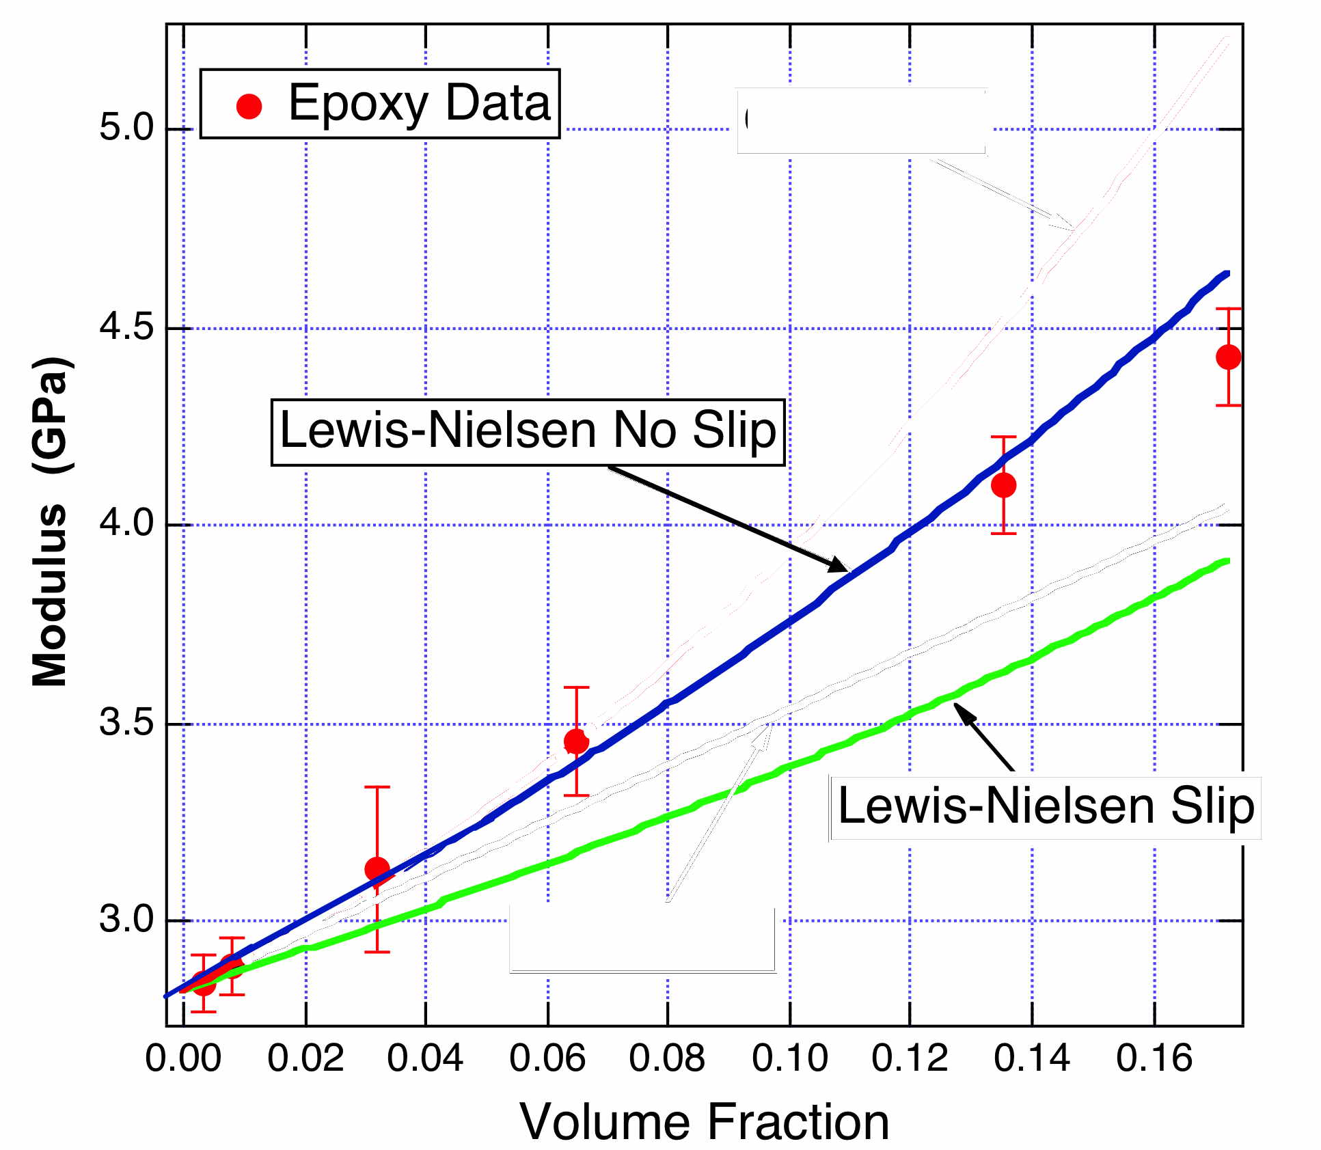
Impact of Filler-Matrix Coupling
Interface modification
effect
Smallwood
Interface bonding does not make much difference
Notes:
Elastic energy is stored in the matrix

Slide 7
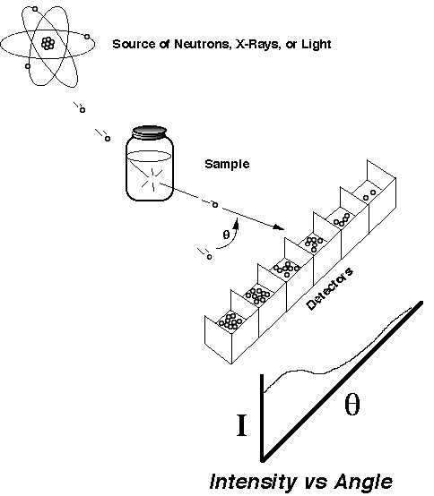
Introduction of Small-Angle Scattering
Bragg Law
XRD
SAXS & SANS: θ < 6°
SAS
Seldom see peaks (disorder)
Quantitative characterization from 0.1 (10 Å) to 400 nm (4000 Å)

Slide 8
Colloidal Silica in Epoxy
EPON 862 + Cure W
500 Å
600 Å
Exclusion zone
Notes:
The composite matrix analyzed in this work is Epon 862 epoxy
resin (diglycidyl ether of bisphenol F epoxy, Shell Corporation)
cured with EpiCure-W(diethyl diamino toluene, Shell Corporation).
Both materials were purchased from Miller-Stephenson Chemical
Company, Inc. In the remainder of this work, we refer to the cured
epoxy system (epoxy + cure agent) as Epon862/W. This resin system
has been studied for aerospace applications due to its high
working temperature, good properties, and low viscosity [27].
These properties are all significant when resin-transfer molding
advanced carbon-fiber-reinforced composites.

Slide 9
The Promise of Nanotube Reinforcement
α = aspect ratio
Can we get achieve the properties of carbon-fiber composite without expensive hand layup?
Richard Smalley: Yes
UC: NO
Schaefer, D. W., & Justice, R. S. (2007). How nano are nanocomposites? Macromolecules, 40(24), 8501–8517.

Slide 10
Modulus of CNTs in Epoxy
Gojny, F. H.; Wichmann, M. H. G.; Fiedler, B.; Schulte, K. Comp. Sci. & Tech. 2005, 65, (15-16), 2300-2313.

Slide 11
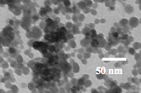
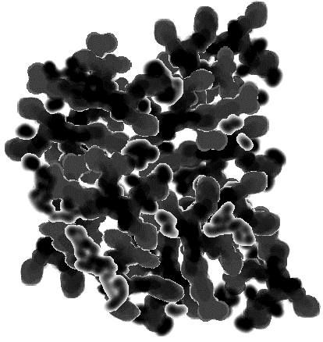

Morphology From Small-Angle X-ray Scattering
Agglomerate
Aggregate
Primary
Particle
Network
“Polymer”
100,000 nm
200 nm
10 nm
0.5 nm
Four Length Scales
Four Morphology Classes
R
G
= 89
μ
Intensity
-3.1
-2.0
Exponents related to
Internal structure
-4.0
10
-7
10
-6
10
-5
0.0001
0.001
0.01
0.1
1
10
q [Å⁻¹] ~ LENGTH⁻¹ ~ sin(θ/2)

Slide 12
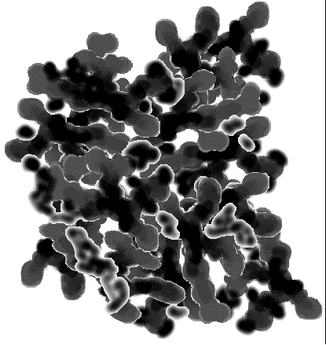
Mass-Fractal Objects
Real Space
d = 3
M ~V ~ R³
M ~V ~ R²
M ~V ~ R¹
M ~V ~ R^{2.2}
Dispersion
M~R^{d}
d = 2
Mass Fractal Dimension = d

Slide 13
Porod Slope for Fractals
I(q)=q^{ds-2d}
Structure
Scaling Relation
Porod Slope = d_{s} – 2d
d_{m} = 3
Smooth Surface
- 4
d
= 2
S
d_{m} = 3
- 3 ≤ Slope ≤ - 4
Rough Surface
2 < d
≤ 3
S
-2.5
1 ≤ d
= d_{m} ≤ 3
- 1 ≤ Slope ≤ - 3
S
Mass Fractal
-1
-2

Slide 14
Morphology of a Complex Colloid from Small-Angle Scattering
Agglomerate
Aggregate
Primary
Particle
Network
“Polymer”
Four Length Scales
Four Morphology Classes
100,000 nm
200 nm
10 nm
0.5 nm
R
G
= 89
μ
Intensity
-3.1
-2.0
Exponents related to
Internal structure
-4.0
10
-7
10
-6
10
-5
0.0001
0.001
0.01
0.1
1
10
q [Å⁻¹] ~ LENGTH⁻¹ ~ sin(θ/2)

Slide 15
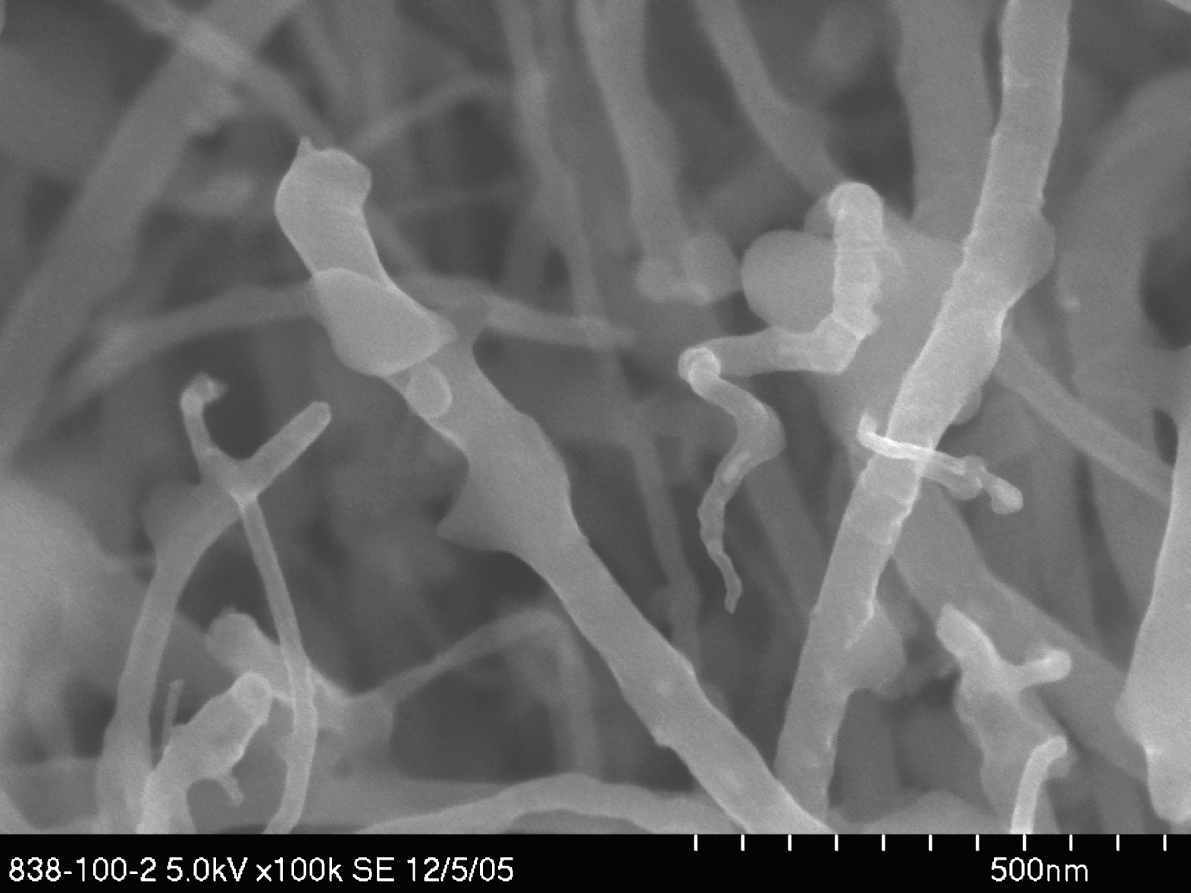
0.01% Loading CNTs in Bismaleimide Resin
Length
Diameter
Surface
Local
Structure
-1
5000 Å
Intensity
LIGHT
SAXS
-4
PD
.00001
.001
.1
10
q(Å
)
-1

Slide 16
0.05% Carbon in Bismaleimide Resin
-1
5000 Å
Intensity
LIGHT
SAXS
-4
PD
.00001
.001
.1
10
q(Å
)
-1
r
L_{p}
Worm-like branched cluster

Slide 17
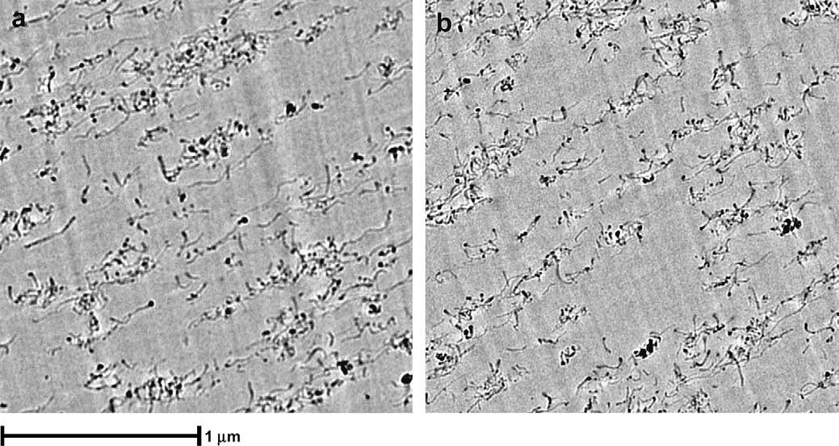
TEM of Nanocomposites
Hyperion MWNT in Polycarbonate
Pegel et al. Polymer (2009) vol. 50 (9) pp. 2123-2132

Slide 18
Morphology and Mechanical Properties
Short Fiber
Halpin-Tsai, random, short, rigid fiber limit
No better than spheres.
Schaefer, D.W. and R.S. Justice, How nano are nanocomposites? Macromolecules, 2007. 40(24): p. 8501-8517.

Slide 19
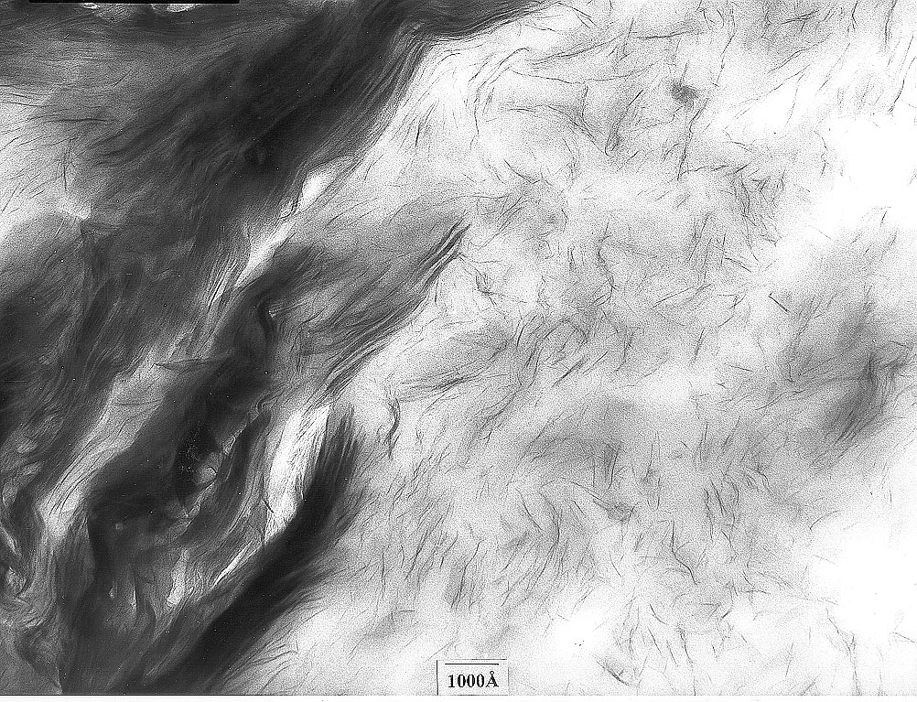
2 dimensional fillers: Clay Reinforced Polymers
2d sheets up to 1 µm

Slide 20
Dispersion of Layered Silicates (Clays)
Exfoliation
Partial
exfoliation
Notes:
In the ideal disk model of exfoliation, this view graph shows a schematic of the process of dispersion. Dispersion may not go all the way to independent particles, in which case SAXS should show the presence of large compact clusters. Such clusters will not show a Porod slope of -2 (characteristic of a thin sheet) and the absolute intensity, which goes a the volume of the object will be much higher than that calculated for single sheets.
When partially exfoliated (or intercalated) diffraction from the layer will also be observed for q>0.1Å⁻¹.

Slide 21
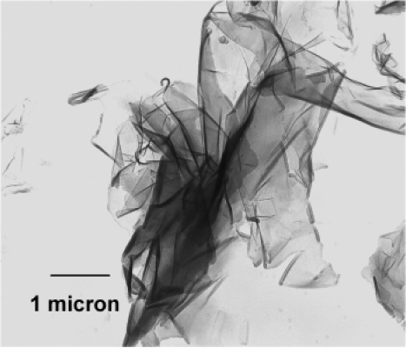
Crumpled Sheet Model
R_{agg}
Idealized
Flexible Sheet Model
1 µm
R_{p}
Short-scale = Disk (d = 2)
Large-scale = Mass Fractal (d = d_{agg})
H
H
R_{agg}
-2
-d_{agg}
R_{p}
I(q)
H
I(q)
H
-4
-2
-4
q
Hartmut Fischer
q
Notes:
In the idealized view often found in the literature regarding dispersed or exfoliated clays, the clay particles are considered to be flat disk-like objects. In reality, there is ample evidence that higly dispersed clay sheets are crumpled. (figure is bentonite mineral. The length scale is much larger than USAX 1/q, but it is clear that there is considerable flesibility even in the unexfoliated clays)
In addition, the percolation threshold is at 1 wt% or less, so inter-particle correlations are likely to be an issue. Both of these issues can be elucidated with ultra small-angle scattering.
This talk will first examine Na Montmorillonite (NaMMT) dispersed in water and then look at organically modified MMT (OMMT) in toluene and melt-compounded innylon66.

Slide 22
Crumpled Surfaces and the Flexible Sheet Model
Notes:
Since the deviations from -2 do not depend on concentration, we attribute them to the morphology of the dispersed sheets. The slope of -2.65 is consistent with mass fractal character on length scales > 80 Å.
The TEM on the left show that sheets can be very crumpled, although this TEM is on larger length scales than measured by USAXS
On the right are simulations of crumpled sheets of increasing fractal dimension. If you crumple paper the fractal dimension increase from 2 (flat sheet) to 2.5 (crumpled ball). The fractal dimension is defined through the mass scaling M ~ r^{D}. In reciprocal space q ~ q^{-D}.

Slide 23
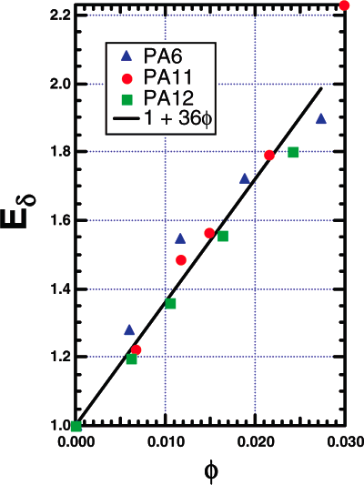
Flexible Sheet Model
Fornes and Paul
Notes:
Here the flexible sheet mode is compared to the 0.1 wt % data with essential perfect agreement using the parameters shown.. The black is light scattering data (very dilute circulation mode in the micromeritics). This fit confirms that the sheets are thin, rough and about 3300 Å in overall size.
The model only assumes power law correlations and allows for other morphologies (branching, for example). That is we cannot eliminate other morphologies that give power-law correlations.

Slide 24
Conclusions
Aggregation is ubiquitous in nanocomposites.
Large aggregates don’t reinforce hard materials.
Large enhancements are due to impact of filler on matrix.
Abusive dispersion may be counterproductive.
Skipping research in favor of “breakthrough materials” is wasteful.
1. Schaefer, D.W., J. Zhao, H. Dowty, M. Alexander, and E.B. Orler, Nanofibre Reinforcement of Soft Materials. Soft Matter, 2008. 4(10): p. 2071 - 2079.
2. Kohls, D.J., D.W. Schaefer, R. Kosso, and E. Feinblum, Silica Fillers for Elastomer Reinforcement, in Current Topics in Elastomers Research, A.K. Bhowmick, Editor. 2008, CRC Press: Boca Raton, FL. p. 505-517.
3. Chen, C., R.S. Justice, D.W. Schaefer, and J.W. Baur, Highly dispersed nanosilica-epoxy resins with enhanced mechanical properties Polymer, 2008. 49(17): p. 3805-3815.
4. Schaefer, D.W. and R.S. Justice, How nano are nanocomposites? Macromolecules, 2007. 40(24): p. 8501-8517.

Slide 25


Acknowledgements
Ryan Justice, Jeff Baur, Janis Brown, Hilmar Koener, Rich Vaia (AFRL)
Chenggang Chen and Dave Anderson (University of Dayton Research Institute)
Jan Ilavsky (Argonne National Laboratory)
Doug Kohls, Jian Zhao, Prashant Rajan (University of Cincinnati)

